Slide 1

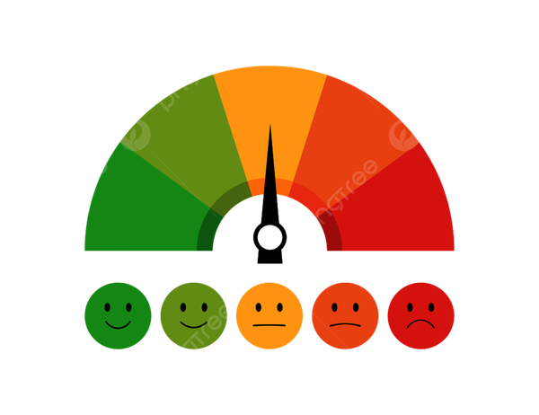
Project Presentation
On
MOODSYNC
Submitted By:
Diya Goyal
2210994878
Sakshi Gupta
2210992228
Supervised By:
Dr. Simarjit Kaur
Associate Professor
Dept. of CSE, CUIET
Department of Computer Science and Engineering, Chitkara University, Punjab

Slide 2


WHY MOODSYNC? –
INTRODUCTION
In today’s fast-paced world, emotional well-being is often overlooked, leading to increased stress and anxiety. Studies show that 57% of people use music to manage stress. Yet, current playback systems rely on manual selection or predefined algorithms that don’t adapt to real-time emotions. Our AI-powered software bridges this gap by using facial recognition to analyze emotions and dynamically play music, enhancing emotional well-being. With applications in mental health, stress management, and emotional awareness, this innovation transforms music into personalized therapy.

Slide 3

POWERING INNOVATION: OUR TECHNOLOGY STACK
Programming Language:
-Python – The core language powering our project.
-JavaScript (Node.js) – Powers the backend server and manages communication.
Machine Learning & Deep Learning:
- TensorFlow & Keras – This is for building and training deep learning models.
- Scikit-Learn – For classical machine learning algorithms and preprocessing.
Data Handling & Processing:
-Pandas – For data manipulation and analysis.
- NumPy – For numerical computing and efficient array operations.
Computer Vision:
- OpenCV (opencv-contrib-python) – For image processing and computer vision tasks.
Backend & Server
-Node.js – Server-side runtime environment to handle frontend requests and route them appropriately.
-Express.js – Web framework for Node.js used to define routes and middleware.
- child_process (Node.js module) – Used to run Python scripts from the Node.js backend.
File Handling
-Multer – Middleware for handling multipart/form-data, especially for uploading frontend images.
Multimedia Output
-Pygame – For audio playback during testing and model validation.
Development & Workflow:
- Jupyter Notebook – For interactive coding, visualization, and experimentation.
- tqdm – For progress bar visualization to track long-running processes.
- GitHub – For version control, collaboration, and communication.

Slide 4

LOAD THE PRE-TRAINED AI MODEL FOR EMOTION DETECTION.
IDENTIFY FACES IN THE VIDEO USING OPENCV’S HAAR CASCADE.
ACCESS THE WEBCAM FOR REAL-TIME VIDEO CAPTURE.
REAL-TIME EMOTION DETECTION WORKFLOW
ENHANCE IMAGE FOR BETTER AI PROCESSING.
CONTINUOUSLY PROCESS FRAMES FOR LIVE DETECTION.
SHOW DETECTED EMOTION ON THE VIDEO FEED.
ANALYZE FACIAL EXPRESSIONS TO DETECT EMOTIONS.

Slide 5

CREATE DATAFRAME WITH EXTRACTED IMAGE PATHS AND LABELS.
LOAD LIBRARIES & DATASET (KERAS, PANDAS AND NUMPY)
LOAD IMAGES, CONVERT TO GRAYSCALE (48X48), NORMALIZE AND RESHAPE FOR MODEL INPUT.
CNN MODEL TRAINING WORKFLOW
SAVE TRAINED MODEL
DEFINE & COMPILE CNN MODEL.
TRAIN THE MODEL USING MODEL.FIT(...) ON THE PROCESSED DATASET.

Slide 6
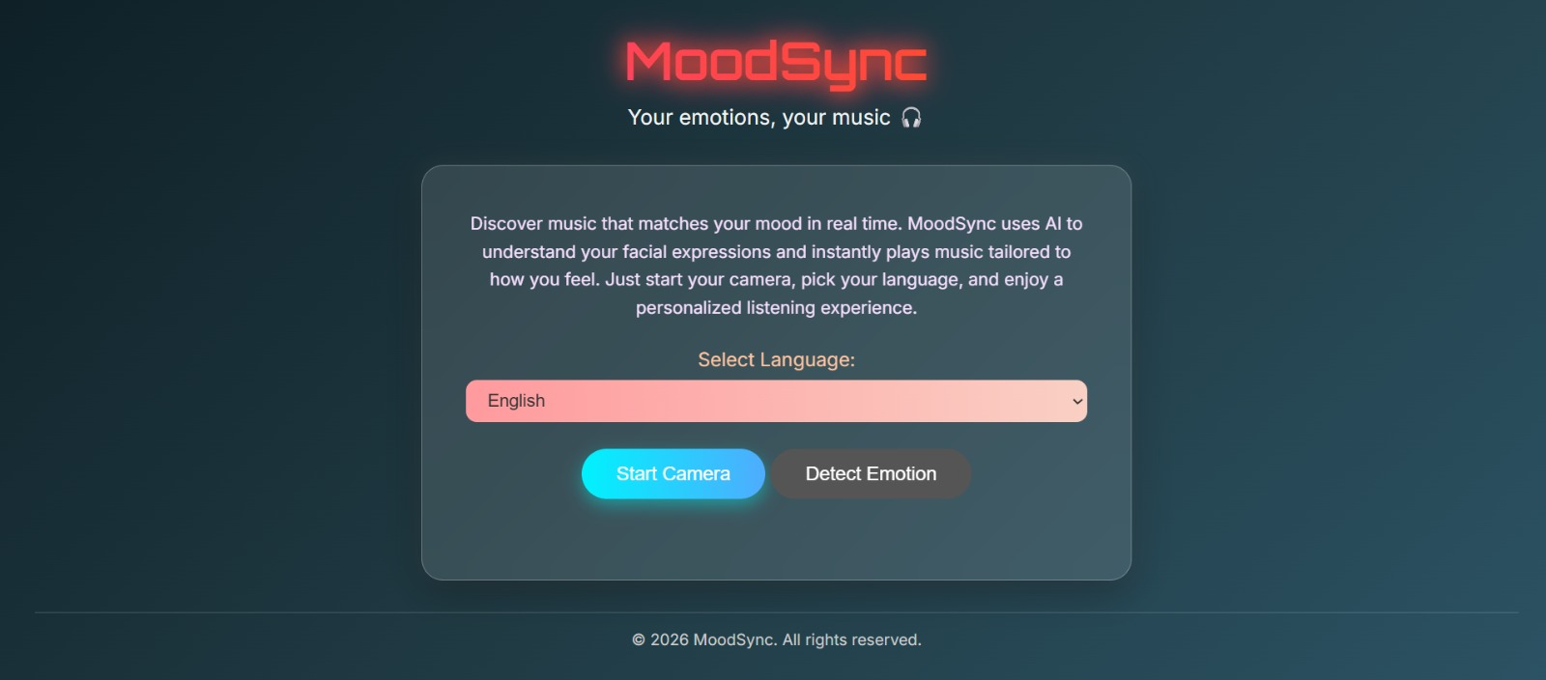
PROJECT EVOLUTION OUTPUT

Slide 7
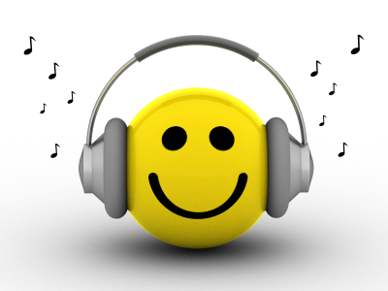
FRONTEND (HTML + JAVASCRIPT)
THE USER SELECTS A LANGUAGE, AND A PHOTO IS CAPTURED VIA WEBCAM.
IMAGE AND LANGUAGE ARE SENT TO HTTP://LOCALHOST:3000/DETECT VIA POST.
BACKEND (NODE.JS + EXPRESS)
RECEIVES IMAGE AND LANGUAGE WITH MULTER, STORES IMAGE IN /UPLOADS.
RUNS EMOTION.PY USING CHILD_PROCESS.EXEC() WITH IMAGE PATH.
EMOTION DETECTION MODEL (PYTHON + KERAS + OPENCV)
PYTHON SCRIPT LOADS CNN MODEL AND DETECTS EMOTION FROM THE IMAGE.
RETURNS THE EMOTION LABEL TO THE NODE.JS SERVER.
Emotion Detection and Music Playback Flow
FRONTEND (AGAIN)
FRONTEND SHOWSTHE DETECTED EMOTION AND OPENS YOUTUBE VIDEO ON THE SAME SCREEN.
YOUTUBE SONG PLAYBACK
NODE.JS CREATES A YOUTUBE SEARCH QUERY USING EMOTION + LANGUAGE.
SENDS THE SEARCH URL AS JSON TO THE FRONTEND.

Slide 8

CONCLUSION
With a powerful CNN at its core, our model transforms raw facial expressions into real-time emotion detection. This breakthrough bridges AI and human emotions, unlocking endless possibilities—from personalized music therapy to mental wellness solutions. The future of emotion-aware technology starts here!

Slide 9
THANK YOU

